Slide 1
WELCOME
Year 7 HASS
2022

Slide 2
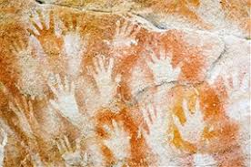
Sources for Ancient Australia

Slide 3
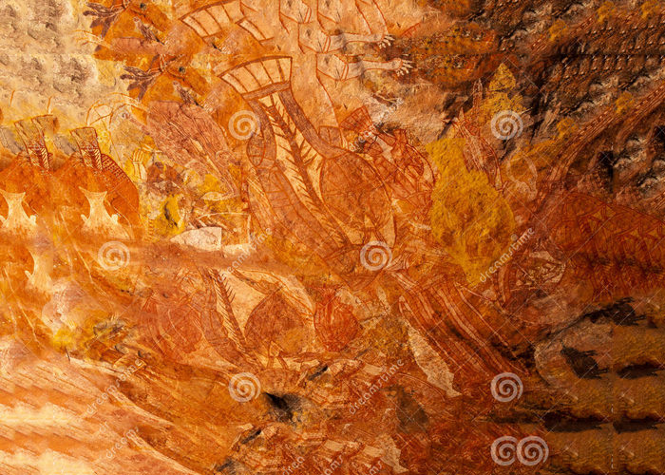
Oral History
Sources for Ancient Australia
For Indigenous societies in Australia we have no written evidence, even though many languages were developed.
We also have no evidence from buildings. Most artefacts, such as tools, weapons and ornaments were made of wood, other plant materials and animal materials such as skin and bone. These decay over time.
Can you think of any evidence that we could use to give us clues about the history of Indigenous people? Split into primary and secondary sources.

Slide 4
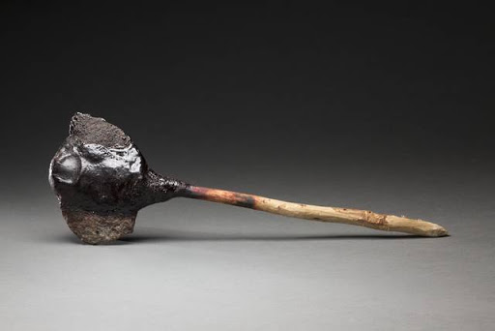
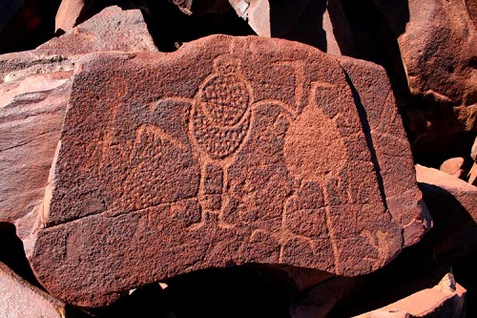
Oral History
Sources for Ancient Australia
Can you think of any evidence that we could use to give us clues about the history of Indigenous people? Split into primary and secondary sources.

Slide 5
Oral History
Evidence: Oral Traditions
This is another way of preserving cultural traditions. It is through oral communication that information is passed on from one generation to the next.
Examples:
-song -art -story telling
-dance -craft making -ceremonies
What kind of information is passed on through word of mouth?

Slide 6
Oral History
Evidence: Oral Traditions
This is another way of preserving cultural traditions. It is through oral communication that concepts and beliefs about The Dreaming are passed on from one generation to the next.
Examples:
-song -art -story telling
-dance -craft making
What information is passed on?
-Laws, rules and cultural practices
-Peoples’ lives and personal stories
-How life was created and how the land and seas were formed (The Dreamtime)

Slide 7
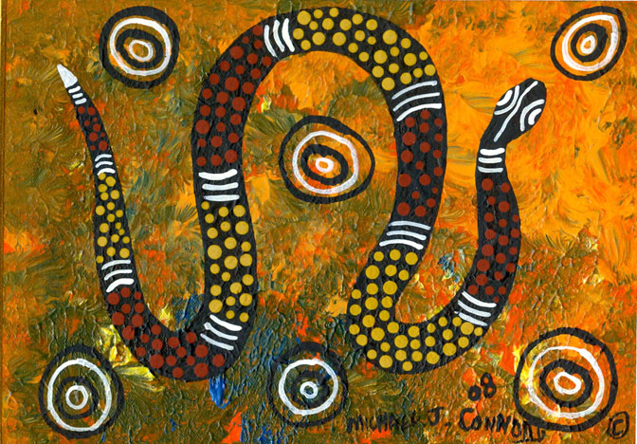
Nyitting- Dreaming
The Nyitting or Dreaming means ‘cold,’ ‘cold time’ or ‘ancestral times.’ Noongar people know it as the dreaming time. It is the time before time when spirits rose from the earth and descended from the sky to create the land forms and all living things. Nyitting stories laid down the lore for social and moral order and established cultural patterns and customs. Noongar creation stories can vary from region to region but they are part of the connection between all living things.
All aboriginal cultures have a different version of the creation story. Have you heard of the rainbow serpent before?

Slide 8
Oral History
Questions
What are oral traditions and why are they used?
Can you think of any of the oral histories of the Pilbara region or the one that you grew up in?
Why is it important for aboriginal people to pass on their history to younger generations?

Slide 9
Oral History
Evidence: Archaeological Evidence
There have been many archaeological discoveries to provide evidence of ancient Australia. They provide us with clues about how they lived in a great variety of environments and adapted to the large changes. There is evidence to show that Aboriginal people have been living in Australia for 65 000 years or more.
For example:
-sites -scarring of trees
-artefacts -art (cave paintings & rock engravings)
-human remains

Slide 10
Oral History
How long ago did humans arrive in Australia?
Aboriginal people are known to have occupied mainland Australia for at least 65,000 years. It is widely accepted that this predates the human settlement of Europe and the Americas. Increasingly sophisticated dating methods are helping us gain a more accurate understanding of how people came to be in Australia. Some of the earliest archaeological sites are found in northern Australia.

Slide 11
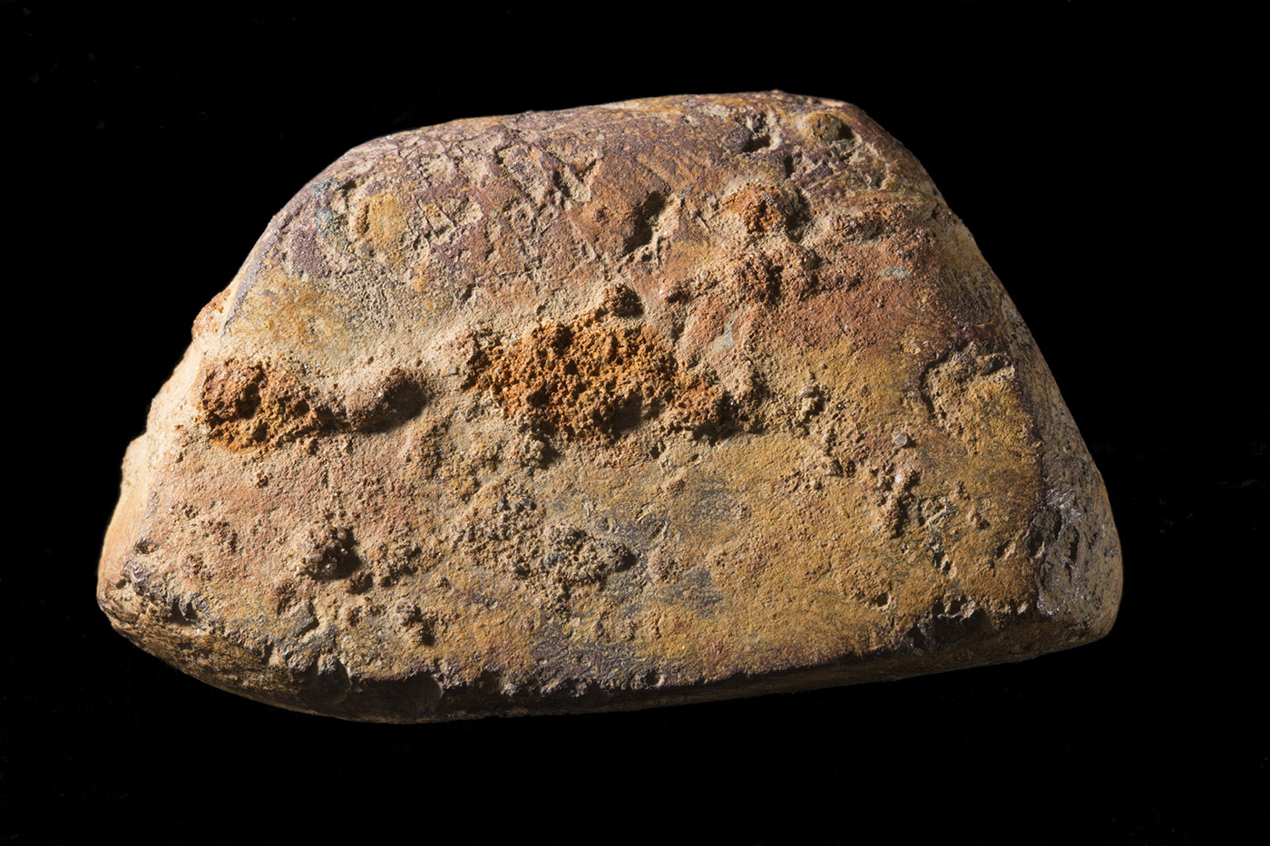
Oral History
How long ago did humans arrive in Australia?
This piece of ochre, excavated from the Madjebebe (Malakunanja II) site in Arnhem Land, is believed to be over 50,000 years old. Other sites of considerable antiquity such as Lake Mungo in New South Wales and Devil’s Lair in south-west Western Australia continue to be discovered and researched across the continent.
Piece of ochre used in what is now Kakadu National Park, 53,000–59,000 years ago

Slide 12
Oral History
Questions
What kinds of archaeological evidence do we have of Aboriginal peoples in Australia?
What are some dating methods that scientists may have used to find out how old these artefacts are?

Slide 13
Oral History
Mungo Man
https://www.youtube.com/watch?v=nt7LrZsU4Fo

Slide 14
Oral History
Mungo Man
Mungo Lady and Mungo Man are perhaps the most important human remains ever found in Australia. Their discovery re-wrote the ancient story of this land and its people and sent shock-waves around the world.
These 42,000 year old ritual burials are some of the oldest remains of modern humans (Homo sapiens) yet found outside of Africa. Mungo Lady is the oldest known cremation in the world, representing the early emergence of humanity's spiritual beliefs.
Mungo Lady and Mungo Man are particularly special to their Aboriginal descendants who still live around the Willandra Lakes area. The Paakantji, Ngyiampaa and Mutthi Mutthi people are proud of what the ancient remains prove of their endurance in the land and survival from the distant past. Many believe that Mungo Man and Mungo Lady returned to teach something to all people.
The return of Mungo Lady and Mungo Man put Lake Mungo on the world map. They led to the establishment of Mungo National Park and the recognition of the Willandra Lakes Region World Heritage Area as a place that is important to all humanity.

Slide 15
Oral History
Questions on Mungo Man/Lady
Why are these discoveries SIGNIFICANT?
What did the discovery of red ochre on Mungo man’s body symbolise?
3. Do you agree with the following statement? Why/Why not? Mungo Man is of great cultural importance to the local Aboriginal people of the Willandra Lakes region. For this reason, scientists should never have removed his skeleton or undertaken such extensive research in the area.

